Slide 1
Arscor Nutrition Development
Utilizing WordPress for E-commerce and Automation

Slide 2
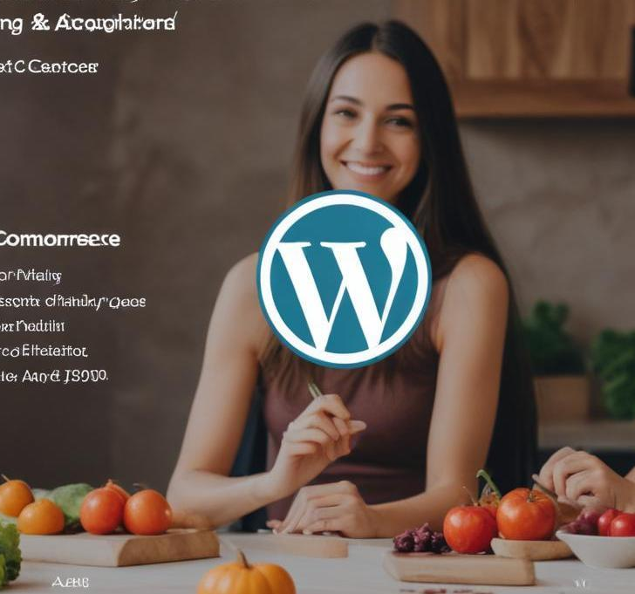
Introduction
This presentation covers key aspects of using WordPress for Arscor Nutrition Development, including WooCommerce integration, website management, and customization.

Slide 3
01
WordPress Overview

Slide 4
Definition and Key Features
WordPress is a powerful content management system (CMS) that allows users to create, manage, and modify content on a website with ease. It features a user-friendly interface, extensive plugin support, and customizable themes, making it accessible for beginners and experts alike.

Slide 5
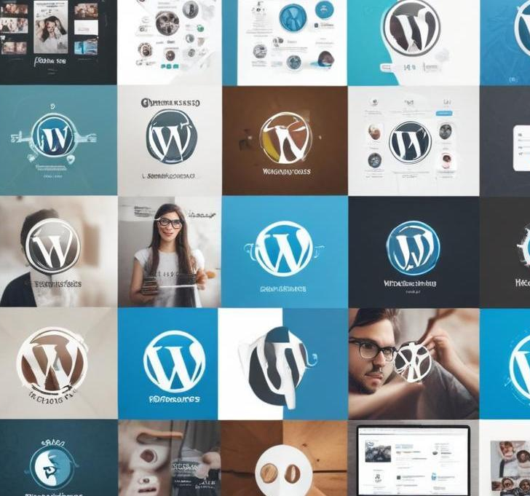
Customization Options
WordPress offers numerous customization options through themes and plugins. Users can create unique layouts, add functionalities such as contact forms, and integrate social media platforms to enhance user engagement and brand recognition.

Slide 6
02
WooCommerce

Slide 7
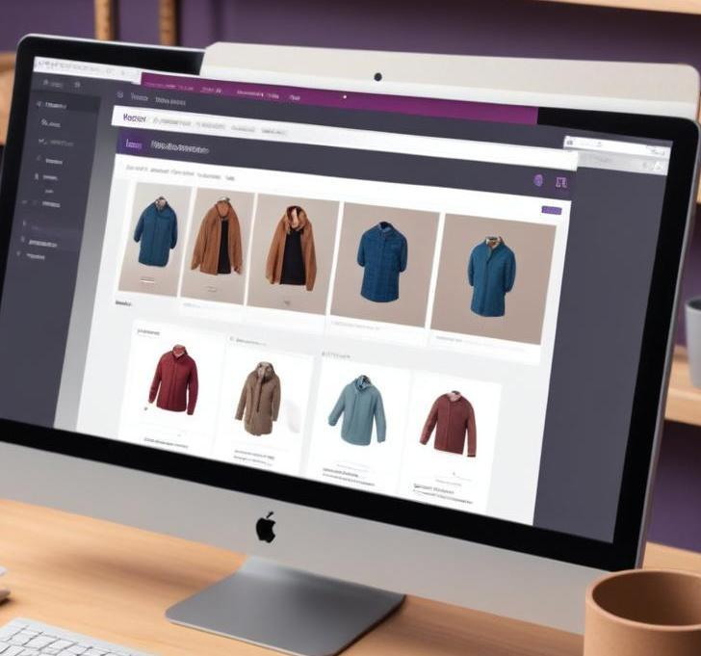
Setting Up an E-commerce Store
WooCommerce is a powerful e-commerce plugin for WordPress, allowing users to set up an online store quickly. Users can add products, manage inventory, set pricing, and handle shipping directly through their WordPress site.

Slide 8
Product Management
Through WooCommerce, users can efficiently manage products by categorizing them, adjusting stock levels, and editing product details. This organization supports a better shopping experience and inventory accuracy.

Slide 9
Payment Options and Security
WooCommerce offers various payment gateway integrations, such as PayPal and Stripe, ensuring secure transactions. Additionally, plugins enable SSL certificates to enhance security, protecting customer data.

Slide 10
03
Website Management

Slide 11
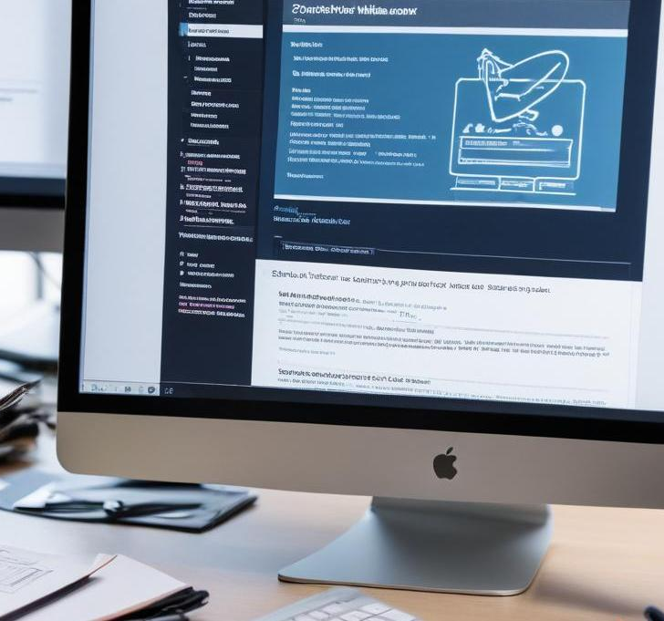
Handling Errors and Crashes
Website errors and crashes can disrupt the user experience and affect sales. To mitigate these issues, regularly monitor website performance, use error logs to identify problems, and implement backup solutions. Utilizing hosting providers that offer uptime guarantees and service monitoring can also enhance stability.

Slide 12
Troubleshooting Techniques
Effective troubleshooting involves several steps: identifying the issue, collecting relevant information, and testing solutions. Common techniques include disabling plugins, switching to default themes, and checking server configurations. Keeping a detailed log of issues helps in diagnosing recurring problems.

Slide 13
04
Custom Design

Slide 14

Creating Custom Pages
Custom pages allow businesses to tailor content to specific audiences. WordPress offers various page builders to create visually appealing layouts. Users can employ shortcodes, widgets, and templates to enhance functionality and meet specific design requirements.

Slide 15
Design Tools and Templates
WordPress provides numerous design tools and templates for customization. Themes can be modified using page builders like Elementor or WPBakery. Users can also find premium templates tailored for specific industries, which facilitate quicker and more professional designs.

Slide 16
User Experience Considerations
A successful website prioritizes user experience (UX) by ensuring intuitive navigation, fast loading times, and mobile responsiveness. Conducting usability tests and gathering user feedback is essential for understanding and improving the visitor's journey on the site.

Slide 17
05
Integrations

Slide 18

Automation Tools Overview
Automation tools streamline operations by minimizing manual effort. Integrations with WordPress can facilitate automatic updates, marketing campaigns, and customer relationship management (CRM). Tools like Zapier and Automate.io enable seamless connections between different applications.

Slide 19
Payment Gateway Integration
Integrating payment gateways ensures secure transactions on e-commerce sites. WooCommerce supports multiple payment options like credit cards, PayPal, and Stripe, providing customers with flexibility. Setting up these gateways involves configuration steps to ensure compliance and security practices are met.

Slide 20
POS Software Use and Benefits
Point of Sale (POS) software connects offline and online sales, improving inventory management and reporting. Integrating POS with WordPress allows for synchronized sales data across platforms, facilitating better business insights. This integration aids businesses in handling transactions efficiently and boosting customer satisfaction.

Slide 21
Conclusions
Leveraging WordPress for Arscor Nutrition Development enables effective management of e-commerce solutions. Incorporating tools like WooCommerce, ensuring robust website management, and utilizing automation and integrations can significantly enhance operational efficiency and customer satisfaction.

